Slide 1
MODULE 1: Introduction to Wireless Communication Fundamentals and 5G Technology
M1 S4
Modulation Techniques: QPSK, QAM, OFDM

Slide 2
Modulation Techniques: QPSK, QAM, OFDM
What Is Modulation?
Modulation is defined as the process of superimposing a low-frequency signal on a high-frequency carrier signal.
Or
The process of varying the RF carrier wave in accordance with the information in a low-frequency signal.

Slide 3
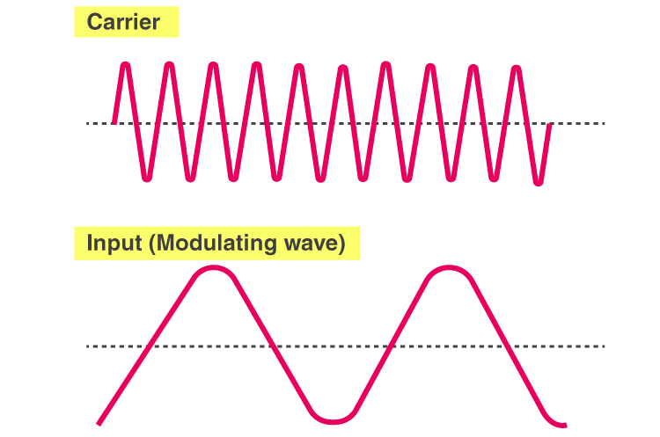
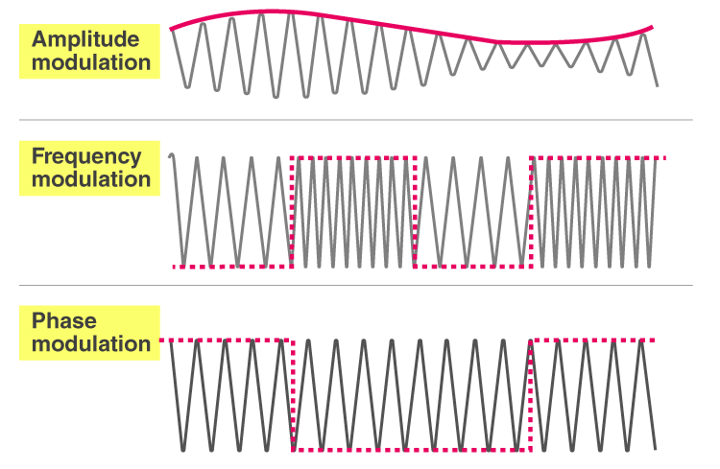
Modulation Techniques: QPSK, QAM, OFDM
The process of varying the RF carrier wave in accordance with the information in a low-frequency signal.

Slide 4
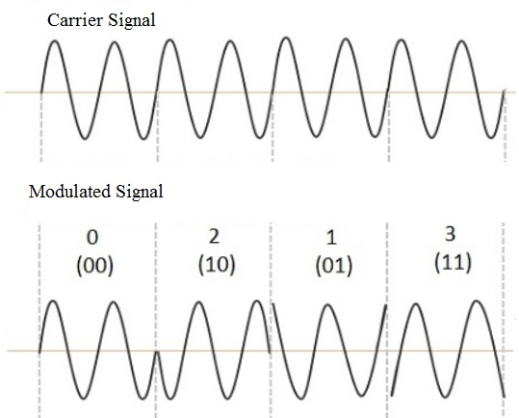
Modulation Techniques: QPSK, QAM, OFDM
QPSK
.

Slide 5
Modulation Techniques: QPSK, QAM, OFDM
What is Quadrature Phase Shift Keying?
Quadrature Phase Shift Keying is a digital modulation method.
In this method, the phase of the carrier waveform is changed according to the digital baseband signal.
The phase of the carrier remains the same when the input logic is the 1 but goes a phase shift when the logic is 0.
In Quadrature Phase Shift Keying, two information bits are modulated at once, unlike Binary Phase Shift Keying where only one bit is passed per symbol.
Here, there are four carrier phase offsets with a phase difference of ±90° for four possible combinations of two bits( 00, 01, 10, 11).
Symbol duration in this modulation is twice the bit duration.

Slide 6
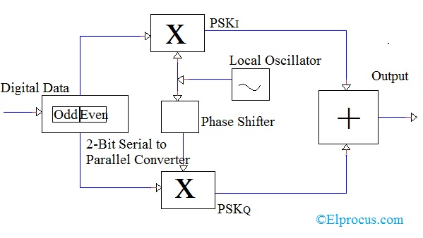
Modulation Techniques: QPSK, QAM, OFDM
Circuit Diagram
Instead of converting bits into a digital stream, QPSK converts it into bit pairs.
This method is also known as the Double Side Band Suppressed Carrier modulation method.
QPSK modulation circuit consists of a bit-splitter, 2-bit serial to parallel converter, two multipliers, a local oscillator, and a summer.

Slide 7
Modulation Techniques: QPSK, QAM, OFDM
Circuit Diagram
90^{O}

Slide 8
Modulation Techniques: QPSK, QAM, OFDM
Circuit Diagram
At the transmitter input, the message signal bits are separated as even bits and odd bits using a bit splitter.
These bits are then multiplied with the same carrier waveform to generate Even QPSK and Odd QPSK signals.
The Even QPSK signal is phase shifter by 90°, using a phase shifter, before modulation.
Here, the Local Oscillator is used for generating the carrier waveform.
After separation of bits, a 2-bit serial to parallel converter is used.
After multiplying with the carrier waveform, both Even QPSK and Odd QPSK are given to the summer when modulation output is obtained..

Slide 9
Modulation Techniques: QPSK, QAM, OFDM
Circuit Diagram
At the receiver end for demodulation, two product detectors are used.
This product detectors convert the modulated QPSK signal into Even QPSK and Odd QPSK signals.
Then the signals are passed through two bandpass filters and two integrators.
After processing the signals are applied to the 2-bit parallel- to-series converter, whose output is the reconstructed signal...

Slide 10
Modulation Techniques: QPSK, QAM, OFDM
Advantages
It provides good noise immunity.
Compared to BPSK, bandwidth used by QPSK is reduced to half.
The information transmission rate of Quadrature Phase Shift Keying is higher as it transmits two bits per carrier symbol.
Carrier power remains constant as the variation in the QPSK amplitude is small.
Effective utilization of available transmission bandwidth.
Low error probability compared to other methods.
Disadvantages
The disadvantage of QPSK compared to BPSK is the circuit complexity....

Slide 11
Modulation Techniques: QPSK, QAM, OFDM
What is Quadrature Amplitude Modulation?
Quadrature amplitude modulation (QAM) is modulation techniques that we can utilize in analog modulation concept and digital modulation concept.
Depending upon the input signal form we can use it in either analog or digital modulation schemes.
In QAM, we can modulate two individual signals and transmitted to the receiver level.
And by using the two input signals, the channel bandwidth also increases.
QAM can able to transmit two message signals over the same channel.
This QAM technique also is known as “quadrature carrier multiplexing”....

Slide 12
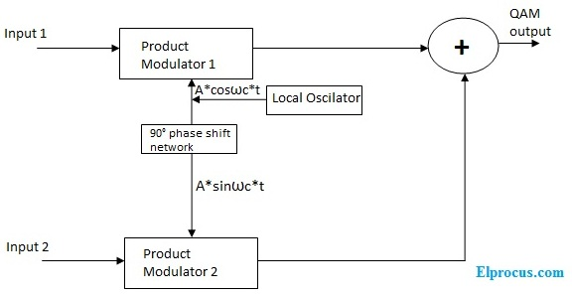
Modulation Techniques: QPSK, QAM, OFDM
Quadrature Amplitude Modulation Block Diagram

Slide 13
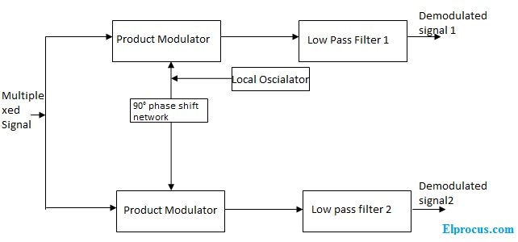
Modulation Techniques: QPSK, QAM, OFDM
Quadrature Amplitude De-Modulation Block Diagram

Slide 14
Modulation Techniques: QPSK, QAM, OFDM
QAM Working Principle
In the QAM transmitter, the above section i.e., product modulator1 and local oscillator are called the in-phase channel and product modulator2 and local oscillator are called a quadrature channel. Both output signals of the in-phase channel and quadrature channel are summed so the resultant output will be QAM.
At the receiver level, the QAM signal is forwarded from the upper channel of receiver and lower channel, and the resultant signals of product modulators are forwarded from LPF1 and LPF2. These LPF’s are fixed to the cut off frequencies of input 1 and input 2 signals. Then the filtered outputs are the recovered original signals

Slide 15
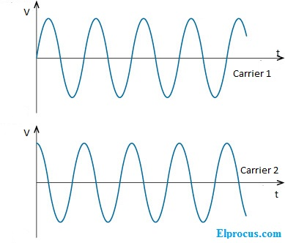
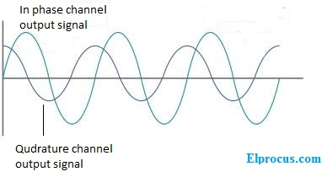
Modulation Techniques: QPSK, QAM, OFDM
QAM Working Principle

Slide 16
Modulation Techniques: QPSK, QAM, OFDM
Advantages of QAM
The quadrature amplitude modulation advantages are listed below.
One of the best advantages of QAM – supports a high data rate. So, the number of bits can be carried by the carrier signal. Because of these advantages it preferable in wireless communication networks.
QAM’s noise immunity is very high. Due to this noise interference is very less.
It has a low probability of error value.
QAM expertly uses channel bandwidth.

Slide 17
Modulation Techniques: QPSK, QAM, OFDM
Orthogonal frequency-division multiplexing (OFDM)
Orthogonal frequency-division multiplexing (OFDM) is a type of digital transmission used in digital modulation for encoding digital (binary) data on multiple carrier frequencies.
OFDM has developed into a popular scheme for wideband digital communication, used in applications such as digital television and audio broadcasting, DSL internet access, wireless networks, power line networks, and 4G/5G mobile communications.
.

Slide 18
Modulation Techniques: QPSK, QAM, OFDM
OFDM is a frequency-division multiplexing (FDM) scheme that was introduced by Robert W. Chang of Bell Labs in 1966
In OFDM, the incoming bitstream representing the data to be sent is divided into multiple streams.
Multiple closely spaced orthogonal subcarrier signals with overlapping spectra are transmitted, with each carrier modulated with bits from the incoming stream so multiple bits are being transmitted in parallel.
Demodulation is based on fast Fourier transform algorithms.
OFDM was improved by Weinstein and Ebert in 1971 with the introduction of a guard interval, providing better orthogonality in transmission channels affected by multipath propagation.

Slide 19
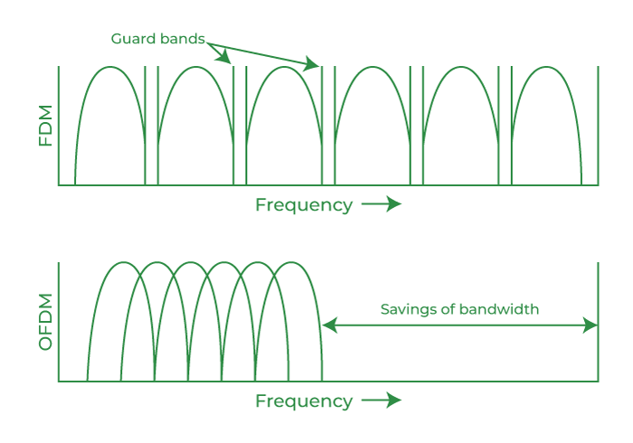
Modulation Techniques: QPSK, QAM, OFDM

Slide 20
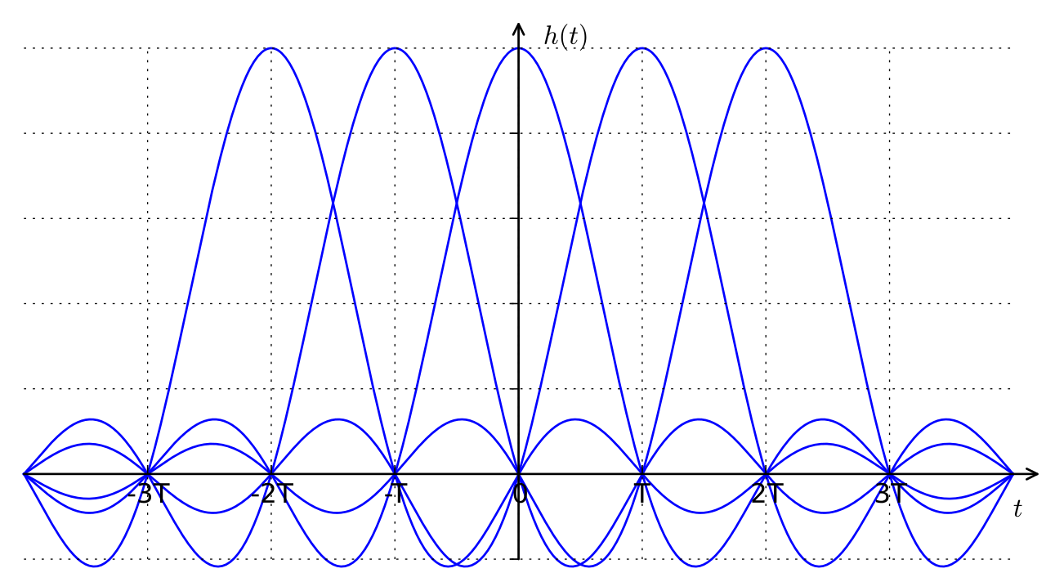
Modulation Techniques: QPSK, QAM, OFDM
Each subcarrier (signal) is modulated with a conventional modulation scheme (such as quadrature amplitude modulation or phase-shift keying) at a low symbol rate.
This maintains total data rates similar to conventional single-carrier modulation schemes in the same bandwidth.

Slide 21
Modulation Techniques: QPSK, QAM, OFDM
Designing OFDM Transmitter:
Consider that we want to send the following data bits using OFDM : D = {d0,d1,d2,…).
The first thing that should be considered in designing the OFDM transmitter is the number of subcarriers required to send the given data.
As a generic case, lets assume that we have N subcarriers.
Each subcarriers are centered at frequencies that are orthogonal to each other (usually multiples of frequencies).

Slide 22
Modulation Techniques: QPSK, QAM, OFDM
Designing OFDM Transmitter:
The second design parameter could be the modulation format that we wish to use.
An OFDM signal can be constructed using anyone of the following digital modulation techniques namely BPSK, QPSK, QAM etc..,
The data (D) has to be first converted from serial stream into parallel stream depending on the number of sub-carriers (N).
Since we assumed that there are N subcarriers allowed for the OFDM transmission, we name the subcarriers from 0 to N-1.
Now, the Serial to Parallel converter takes the serial stream of input bits and outputs N parallel streams (indexed from 0 to N-1). .

Slide 23
Modulation Techniques: QPSK, QAM, OFDM
Designing OFDM Transmitter:
These parallel streams are individually converted into the required digital modulation format (BPSK, QPSK, QAM etc..,).
Lets call this output S0,S1,..SN.
The conversion of parallel data (D) into the digitally modulated data (S) is usually achieved by a constellation mapper, which is essentially a look up table (LUT).

Slide 24
Modulation Techniques: QPSK, QAM, OFDM
Designing OFDM Transmitter:
Once the data bits are converted to required modulation format, they need to be superimposed on the required orthogonal subcarriers for transmission.
This is achieved by a series of N parallel sinusoidal oscillators tuned to N orthogonal frequencies (f0,f1,…fN-1).
Finally, the resultant output from the N parallel arms are summed up together to produce the OFDM signal. .

Slide 25
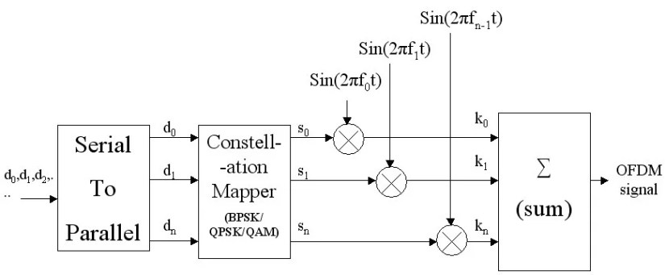
Modulation Techniques: QPSK, QAM, OFDM
Designing OFDM Transmitter: Try to visualize here.

Slide 26
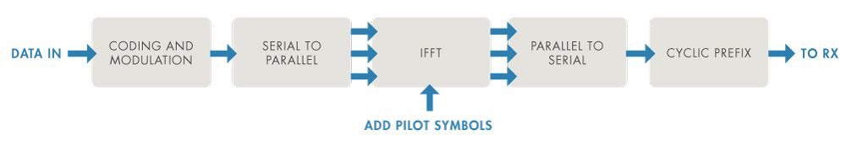
Modulation Techniques: QPSK, QAM, OFDM
Designing OFDM Transmitter: Another Diagram again try to visualize here.

Slide 27
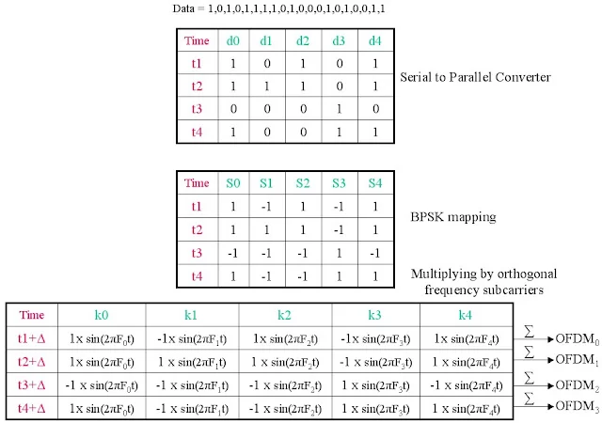
Modulation Techniques: OFDM

Slide 28
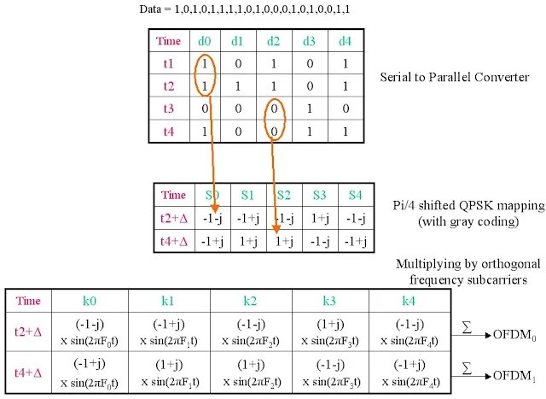
Modulation Techniques: OFDM

Slide 29
!!THANK YOU!! !! Have a Nice Day!!
Today we learned about
Modulation Techniques: QPSK, QAM, OFDM

